Slide 1
First-time Qwiklab Account Setup
Go to https://h2oai.qwiklab.com/
Click on “JOIN”
Create a new account with a valid email address
You will receive a confirmation email
Click on the link in the confirmation email
Go back to http://h2oai.qwiklab.com and log in
Go to the Catalog on the left bar
Choose “H2O and Sparking Water Workshop”
Wait for instructions

Slide 2
H2O-3 and Sparkling Water Workshop
Megan Kurka / Tom Kraljevic
H2O.ai

Slide 3
Agenda
Introduction to H2O-3
Hands On
Data Cleaning and Supervised Learning
Introduction to Sparkling Water
Hands On
Feature Engineering for Time Series and AutoML
Questions and Answers

Slide 4
H2O Overview

Slide 5
H2O Products

Slide 6
What is Machine Learning?

Slide 7

Supervised Learning
Regression:
How much will a customer spend?
Classification:
Will a customer churn?
yes
no
y
x_{j}
X
x_{i}
H₂O algos:
Penalized Linear Models
Random Forest
Gradient Boosting
XGBoost
Neural Networks
Stacked Ensembles
H₂O algos:
Penalized Linear Models
Naïve Bayes
Random Forest
Gradient Boosting
XGBoost
Neural Networks
Stacked Ensembles

Slide 8
Unsupervised Learning
Clustering:
Grouping rows – e.g. creating groups
of similar customers
Feature extraction:
Grouping columns – Create a small
number of new representative
dimensions
Anomaly detection:
Detecting outlying rows - Finding
high-value, fraudulent, or
weird customers
Fraudster
x_{j}
x_{j}
x_{j}
PC₁ = -0.3 x_{i} - 0.4 x_{i}
Billionaire
x_{i}
x_{i}
x_{i}
H₂O algos:
k – means
H₂O algos:
Principal components
Generalized low rank models
Autoencoders
Word2Vec
H₂O algos:
Principal components
Generalized low rank models
Autoencoders

Slide 9

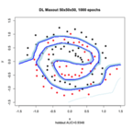
Simplified Typical Machine Learning Pipeline
Features
Target
+
Data Quality
& Transformation
Model
Building
Model
Data
Integration
Modeling
Table

Slide 10
H2O-3

Slide 11
What is H2O?
Math Platform
Open source in-memory AI engine
Parallelized and distributed algorithms
Tech and API
Easy to use and adopt
Written in Java – perfect for Java Programmers
Big Data
More data? Or better models? BOTH
Use all of your data – model without sampling
GLM, Random Forest, GBM, Deep Learning, etc.
REST API (Java) – run H2O from R, Python, WebUI
More Data + Better Models = Better Predictions
Install is lightweight

Slide 12

H2O Cluster
H2O

Slide 13

H2O Clients
H2O Cluster
H2O
H2O

Slide 14
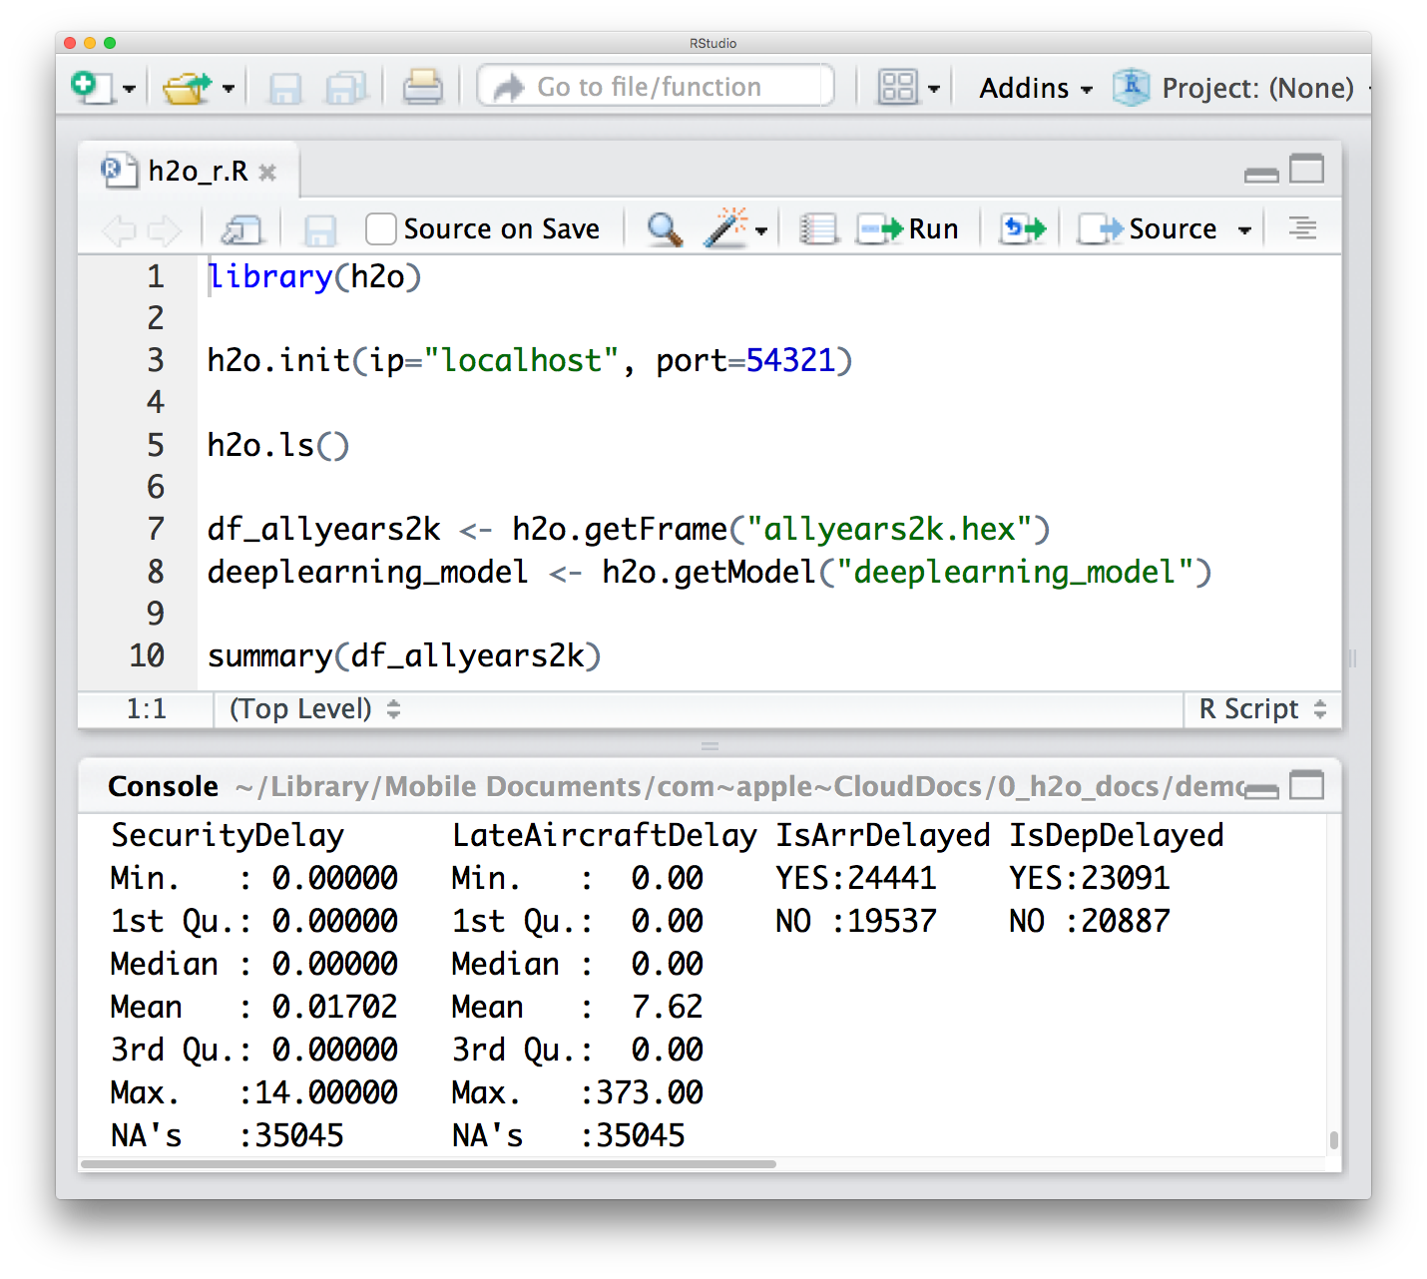



H2O Cluster
H2O
REST/ JSON
H2O
Local
Machine

Slide 15
H2O Cluster
H2O
REST/ JSON
H2O
Local
Machine

Slide 16

H2O Cluster
H2O
REST/ JSON
Local
Machine

Slide 17
H2O
REST/ JSON
JVM 1
JVM 2
JVM N
Local
Machine

Slide 18
H2O Cluster
H2O
REST/ JSON
JVM 1
JVM 2
JVM N
Local
Machine

Slide 19
H2O Cluster
H2O
REST/ JSON
x1 | x2 | x3 | … | xp | y
JVM 1
JVM 2
JVM N
Local
Machine

Slide 20
cluster returns
frame key
H2O Cluster
H2O
REST/ JSON
x1 | x2 | x3 | … | xp | y
JVM 1
JVM 2
JVM N
Local
Machine

Slide 21
H2O-3 Hands On

Slide 22
The Data
Lending Club peer-to-peer loan default dataset
Covers loans issued in years 2007-2011
42,538 loans
Type of information | Column names
Demographic Information | annual_inc, home_ownership, emp_length
Loan Information | purpose, term, desc, int_rate
Response Column | bad_loan

